Slide 1
CNN Vertex Reconstruction:
Summer Work Summarized
Julia Willison
MSU IceCube ML Group

Slide 2
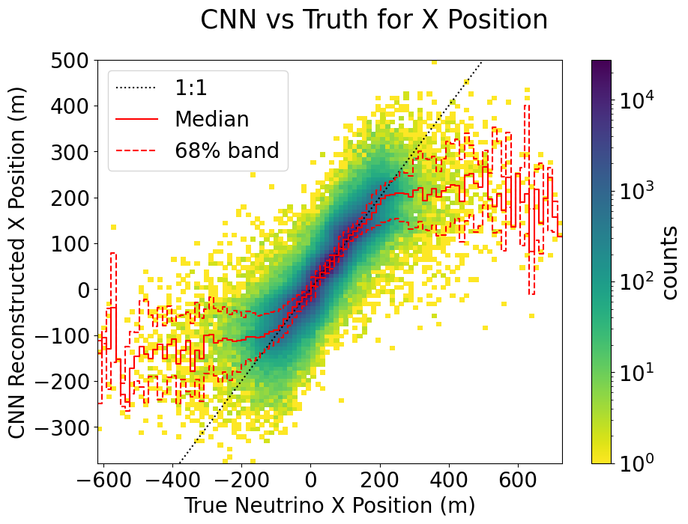
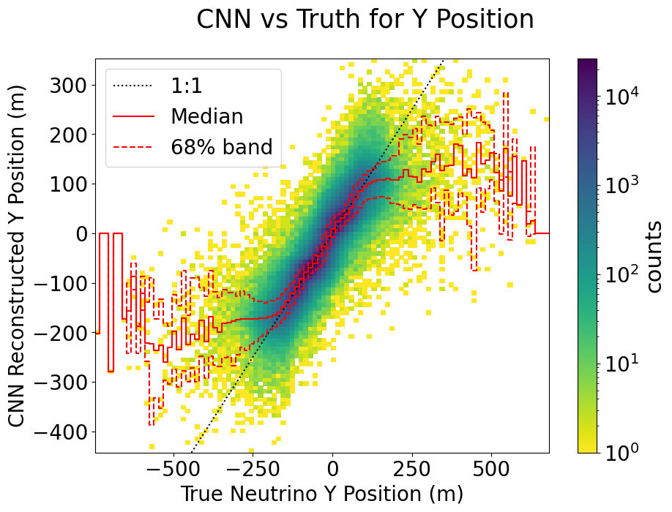
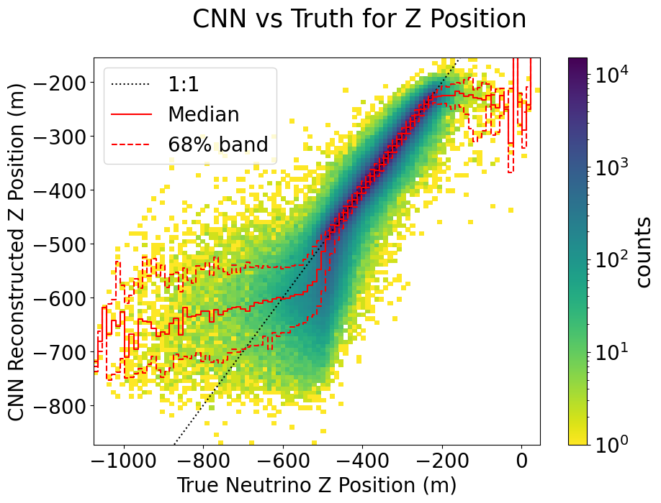
Initial Training and Testing: A Success!
Similar results as Retro Reco
Success reconstructing within DeepCore
As expected, less successful reconstructing outside DeepCore

Slide 3
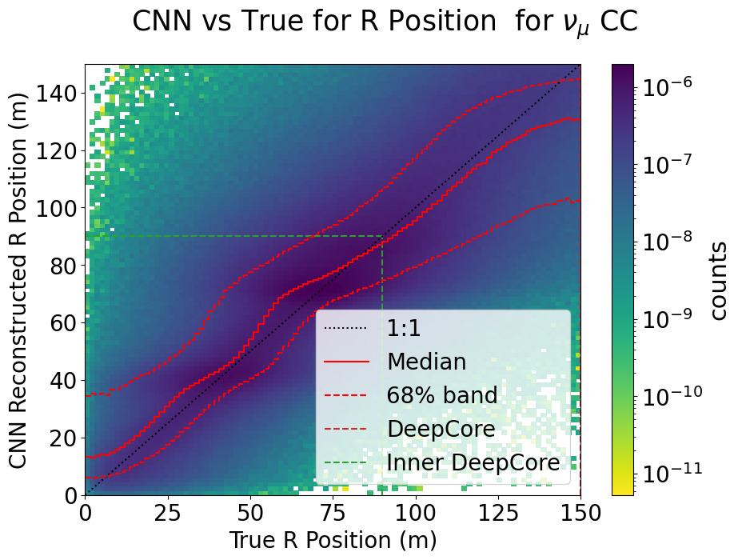
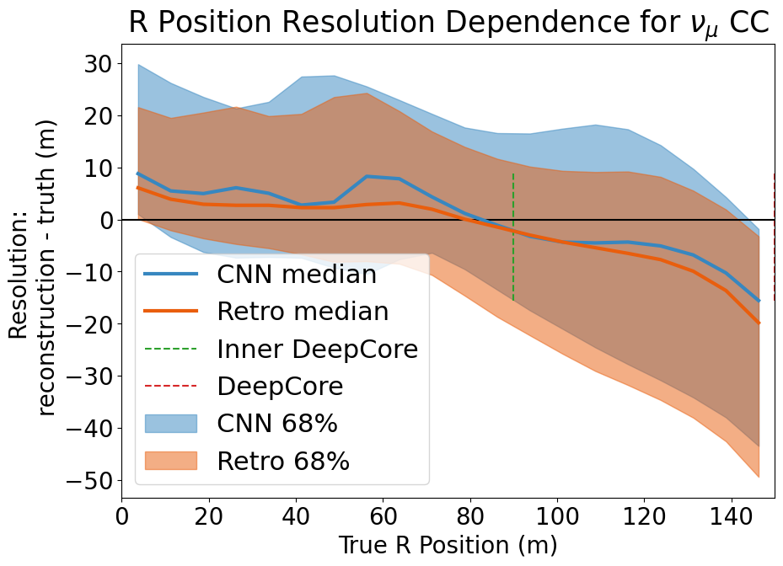
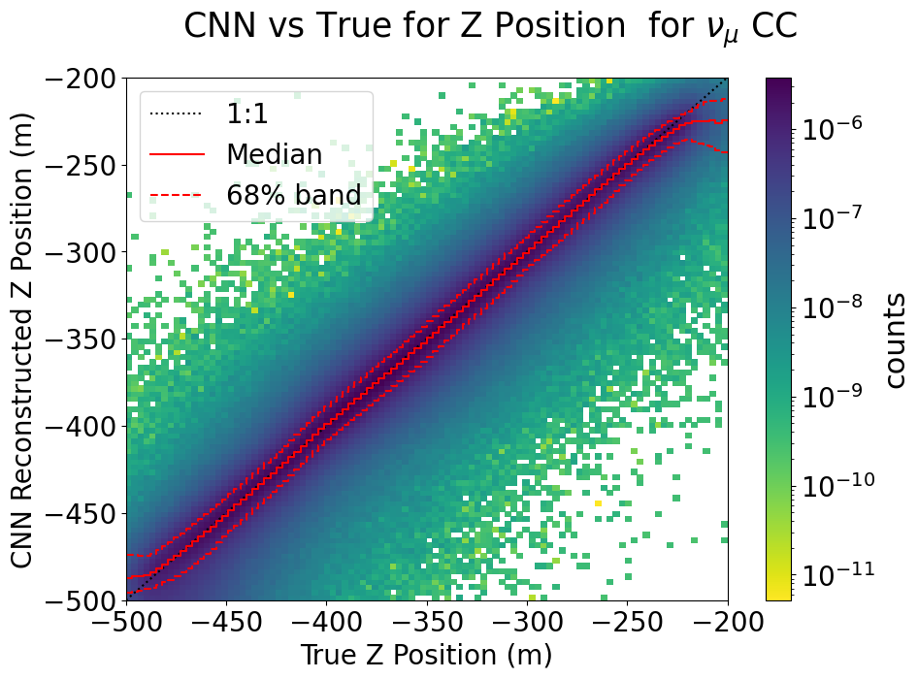
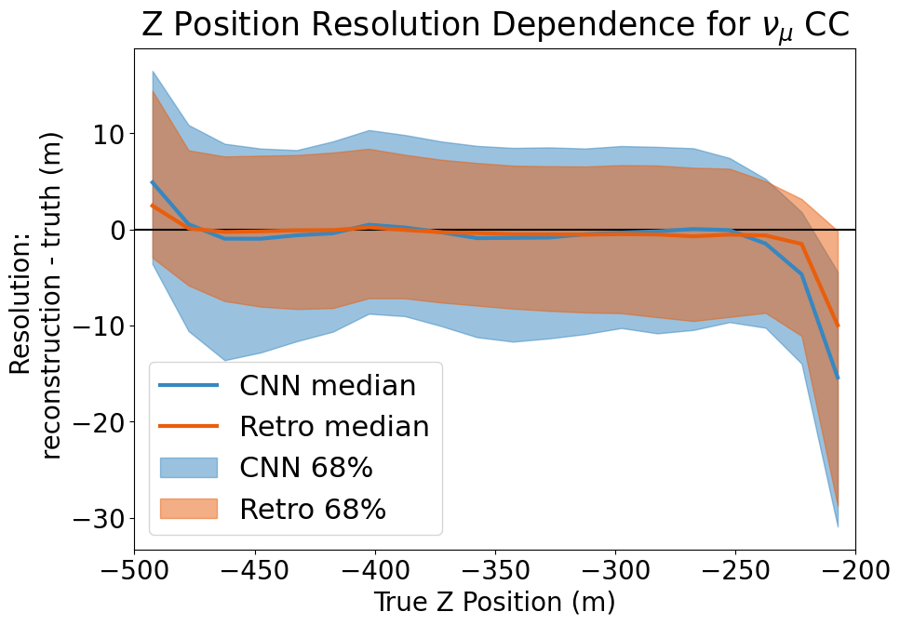
Calculating R and Working on Containment Cuts
Very Pretty Plots
No Really look at that Z
Results comparable to Retro
Yay Go Go DeepCore!
Could we improve by training for R?
Current version: train XYZ, calculate R
Maybe, we didn’t get to try that

Slide 4
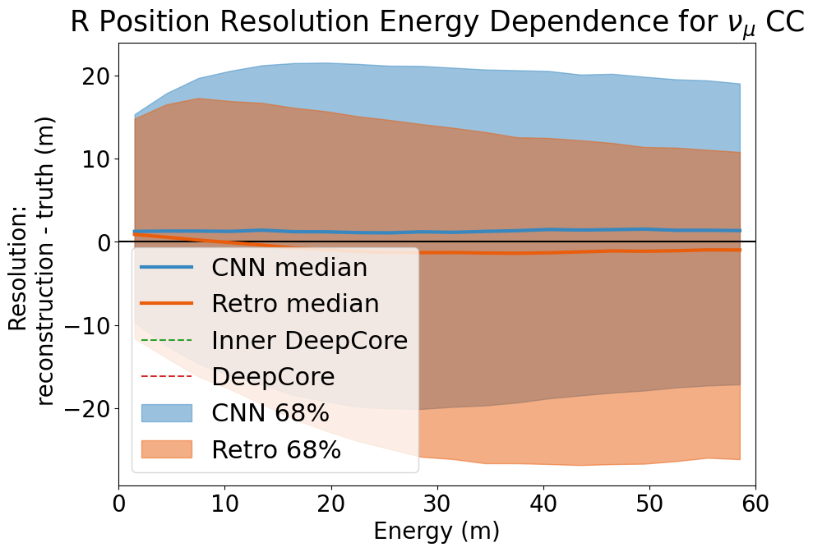
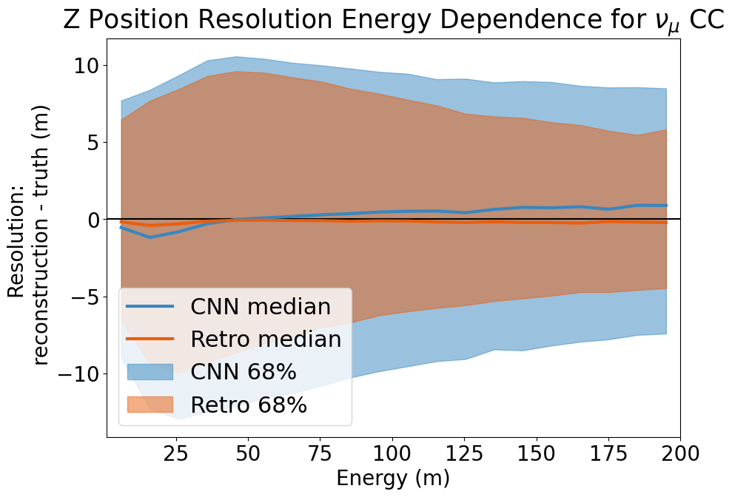
Checking for Energy Dependence
Showed no significant dependence on Energy in R or Z
Yay! That’s what we were hoping

Slide 5
Playing with Confusion Matrices
CNN R < 150 | True Contained | True Cut |  | Retro R < 150 | True Contained | True Cut
CNN Contained | 85.4914% | 2.5628% |  | Retro Contained | 86.7657% | 3.3193%
CNN Cut | 3.1182% | 8.8277% |  | Retro Cut | 1.8439% | 8.0712%
CNN -500 < Z < -200 | True Contained | True Cut |  | Retro -500 < Z < -200 | True Contained | True Cut
CNN Contained | 87.0742% | 0.4471% |  | Retro Contained | 90.1845% | 1.3630%
CNN Cut | 3.9193% | 8.5595% |  | Retro Cut | 0.8089% | 7.6436%
Gave us a better picture of how we compare with Retro
CNN taking out more events than Retro
Tending to cut true contained events rather than leave in uncontained events
Retro tends to leave in uncontained events rather than cut true events

Slide 6
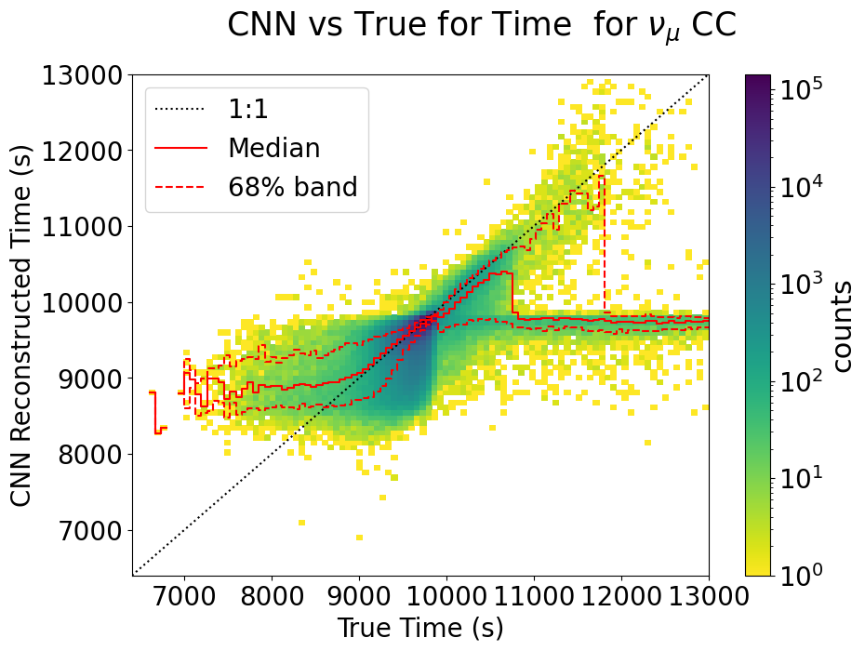
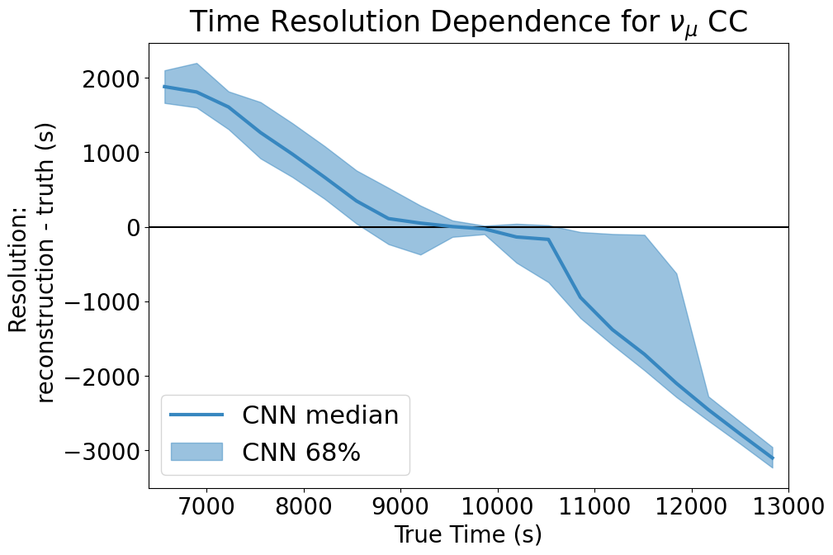
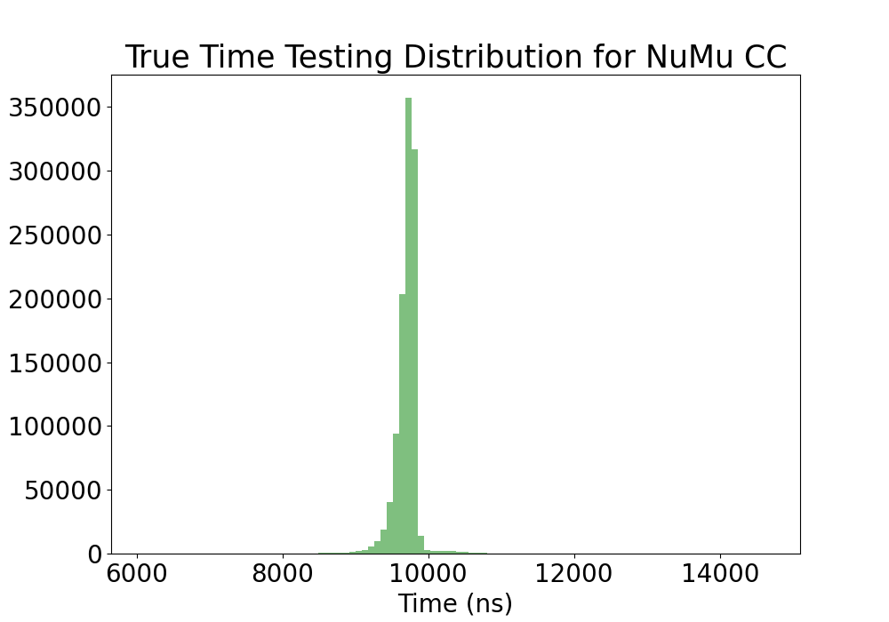
Training and Testing for Time
A struggle
Distribution of true time was too clustered to get a “good” resolution
Possible fixes: Adding random time offsets to the time to get a better distribution to give to the CNN to train and test

Slide 7
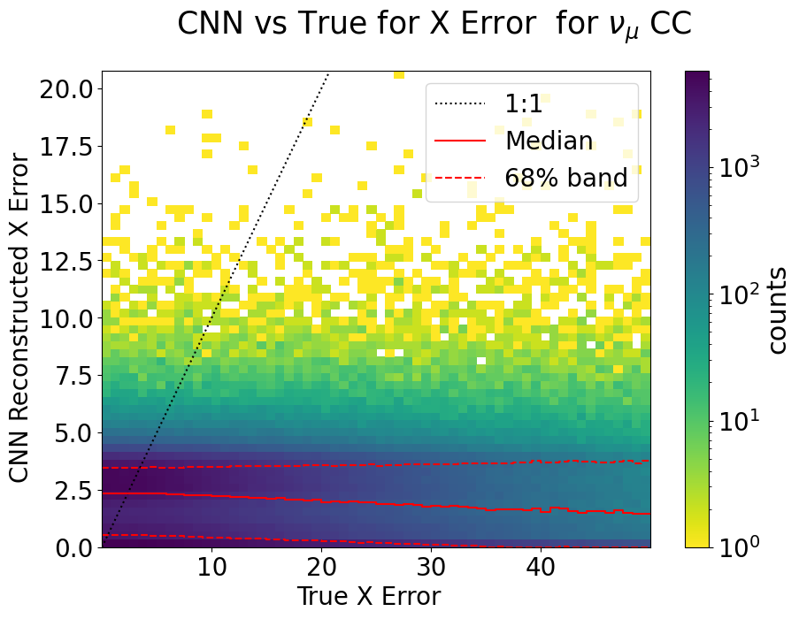
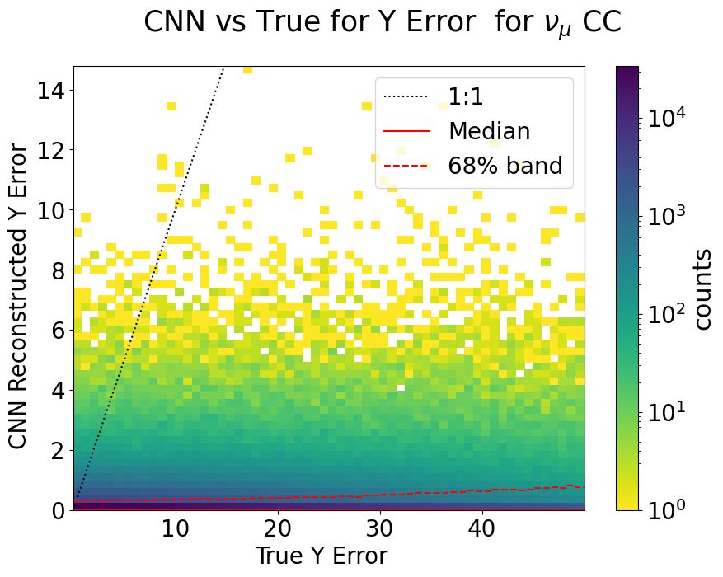
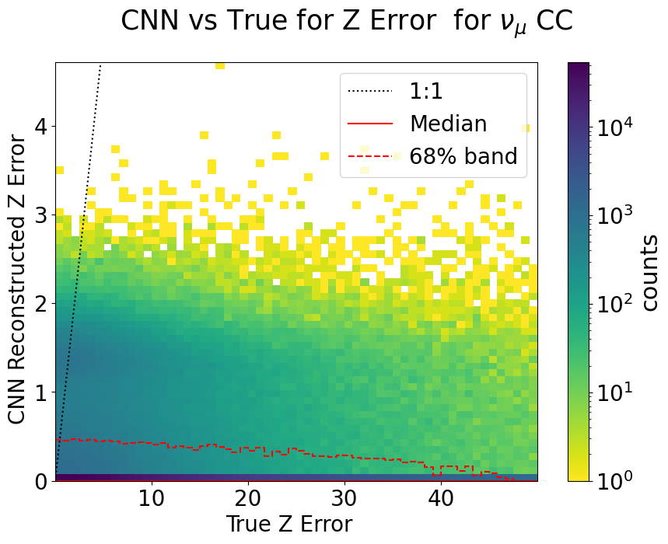
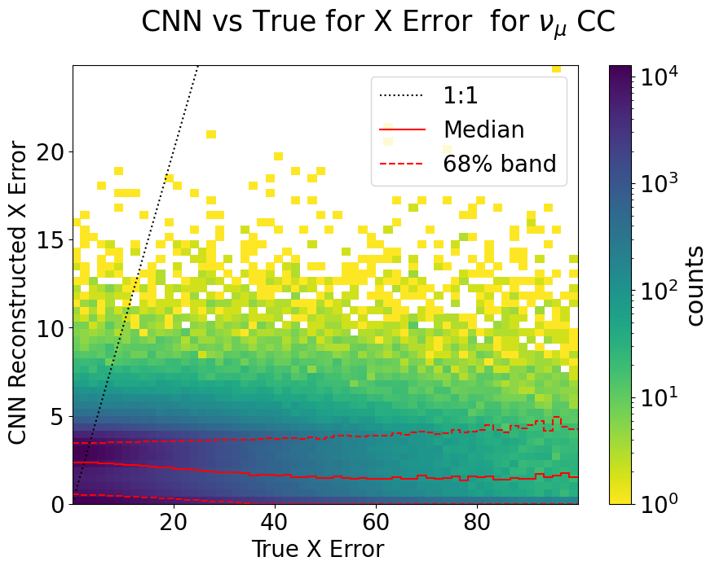
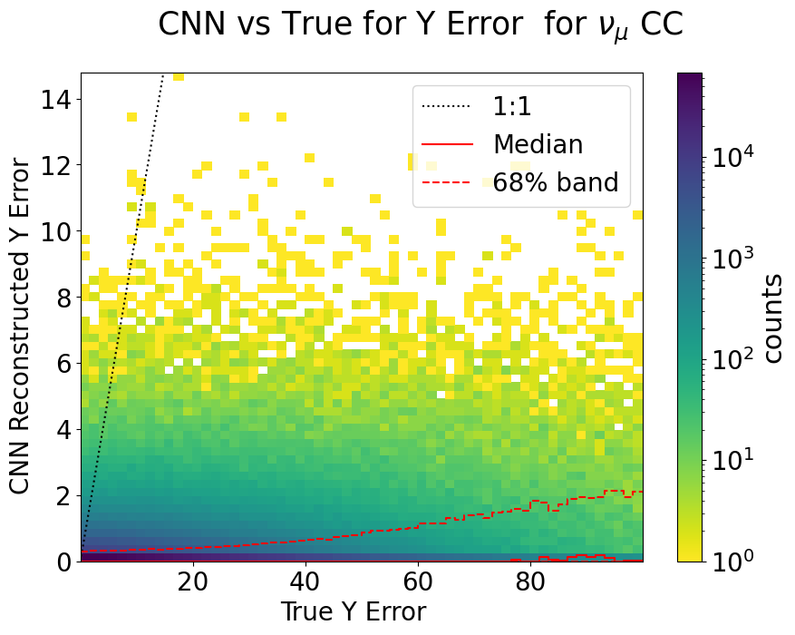
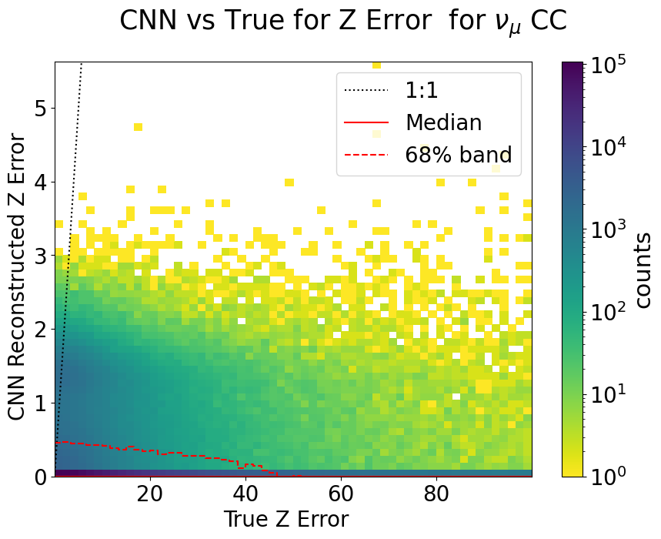
Training and Testing for Vertex Error
Not doing great “predicting” the error
Hoping for prediction trends (if not 1:1) to make cuts
Needs more work to be effective for what we want

Slide 8
Summarizing the Summer Summary
Project Advancements
Vertex successfully reconstructed
Good resolution
No explicit energy dependence
Containment cuts are able to made relatively accurately
Ultimate goal of applying containment cuts to events while reconstructing energy, zenith, etc
Reconstructing time thus far unsuccessful
Potential for future work
Predicting vertex error thus far unsuccessful
Potential for future work here as well
Personal Advancements
Gained a lot of coding experience
First job that involved programming!!
Python! Python! Python!
Some Bash too!
First time remoting into a large server!
Plots! Plots! Plots!
Presented at APS DPF 2021
Good experience presenting outside of my typical field
Met a lot of awesome people
Unfortunately only virtually :(

Slide 9
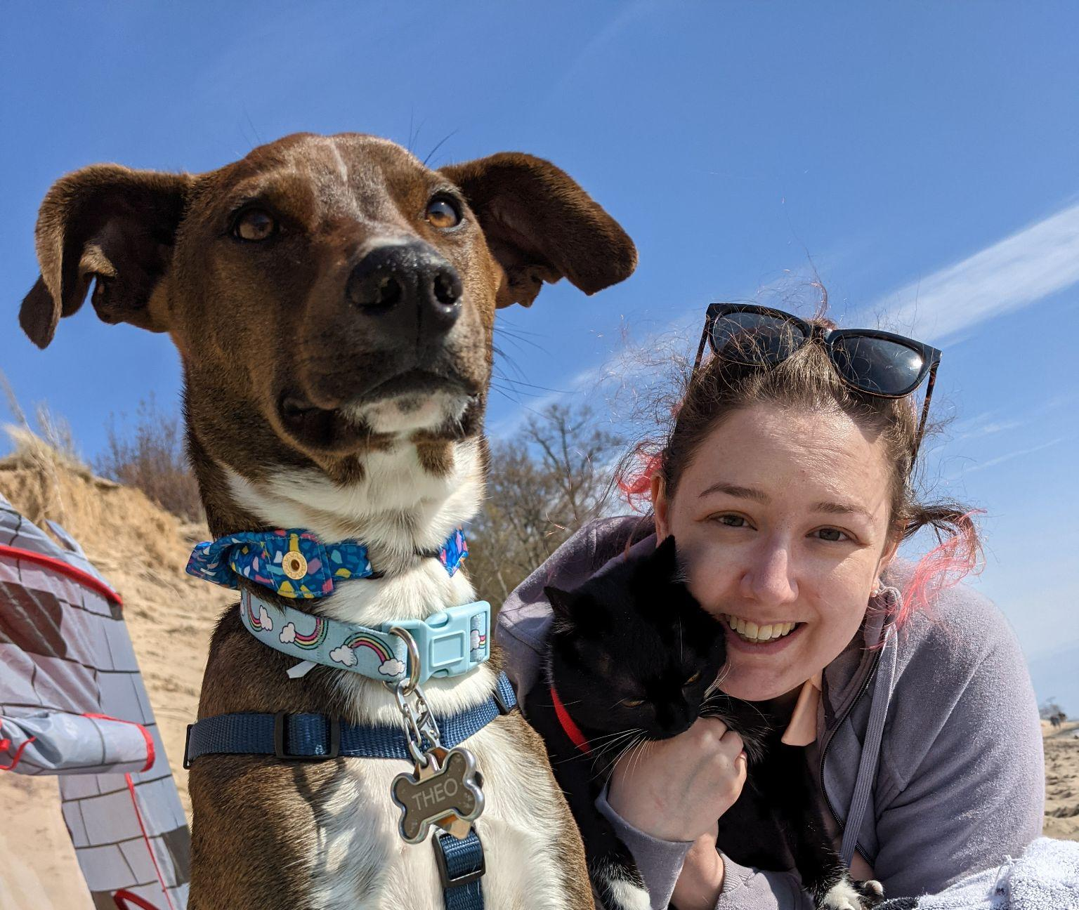
Thank you all for your help and support!
Have a lovely semester!

